Slide 1
Pipeline

Slide 2
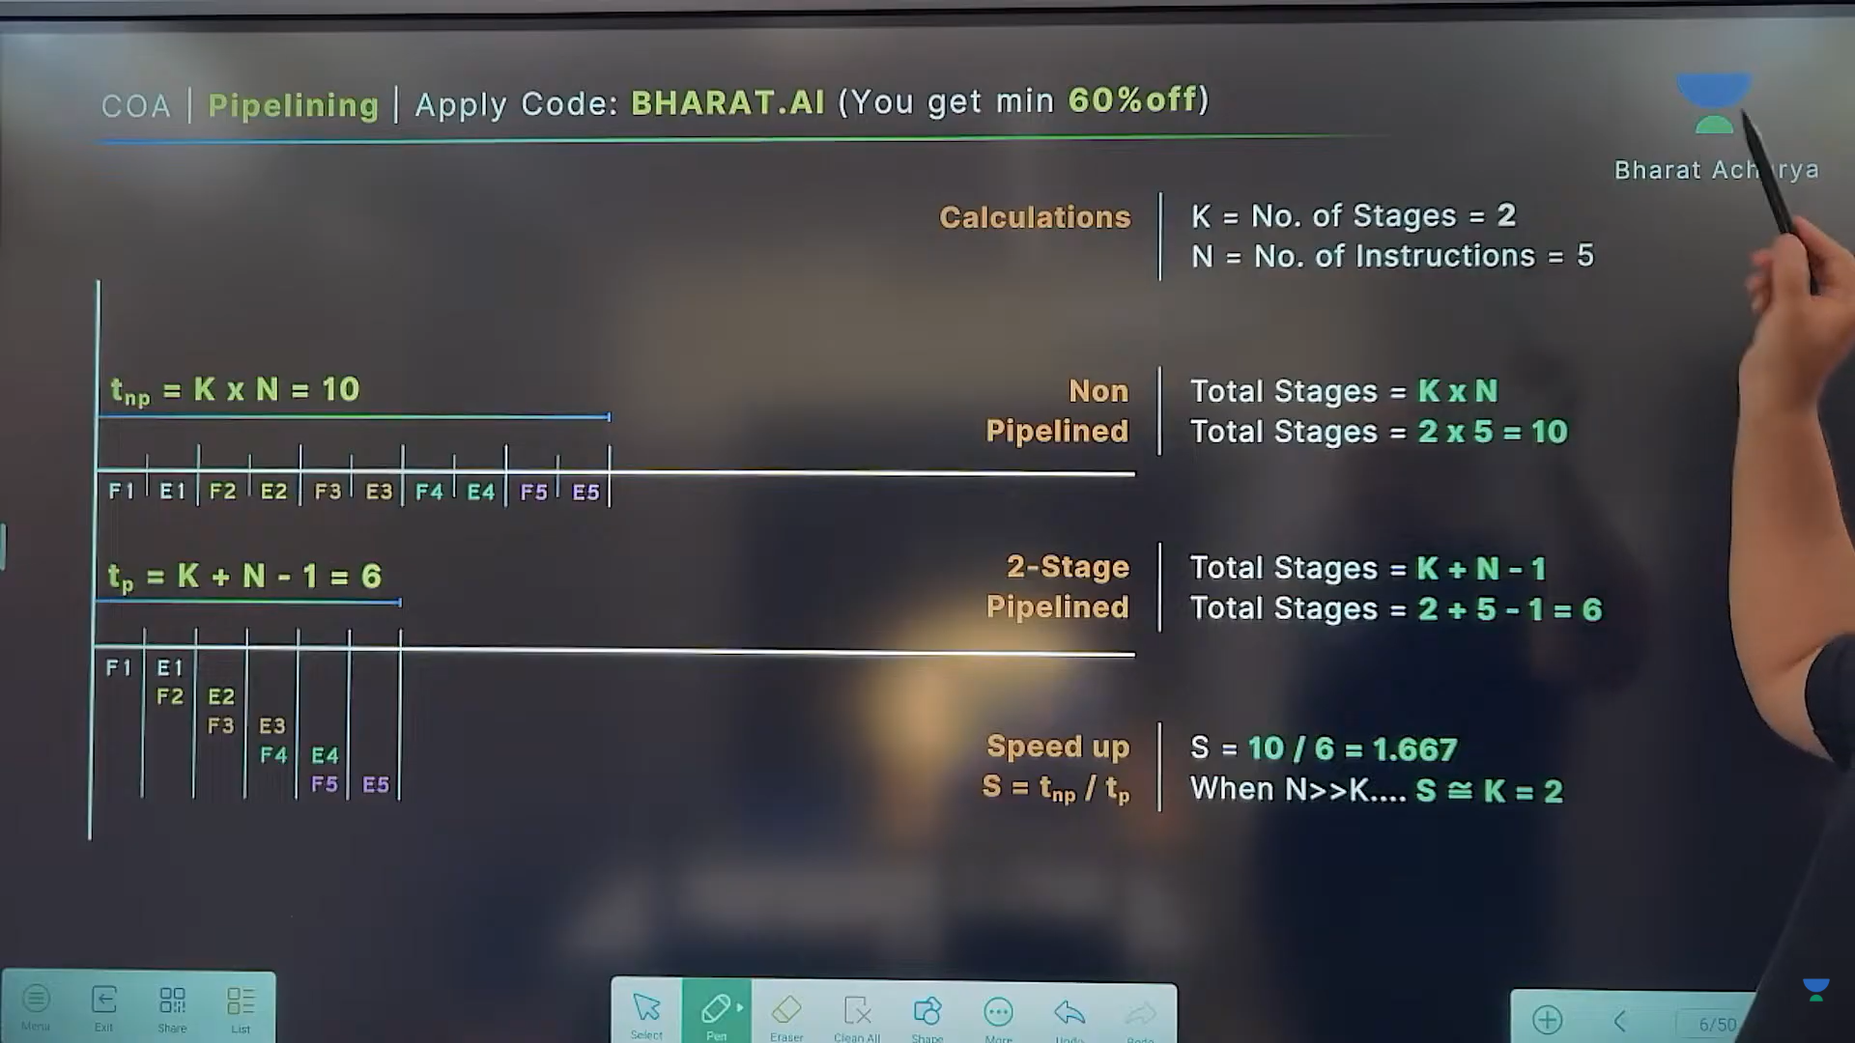

Slide 3
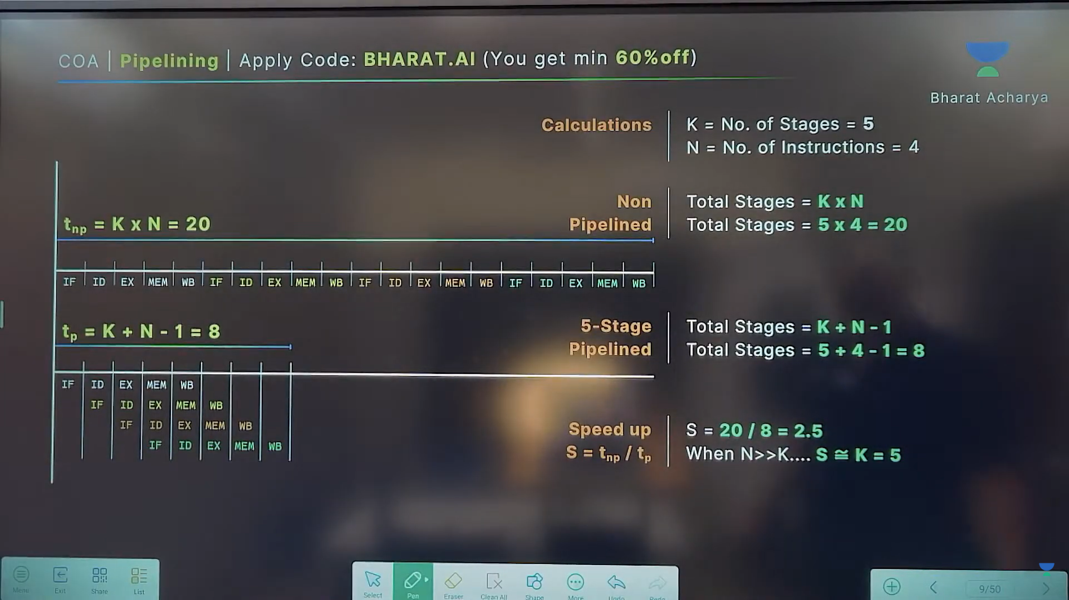

Slide 4
